Slide 1
Development

Slide 2
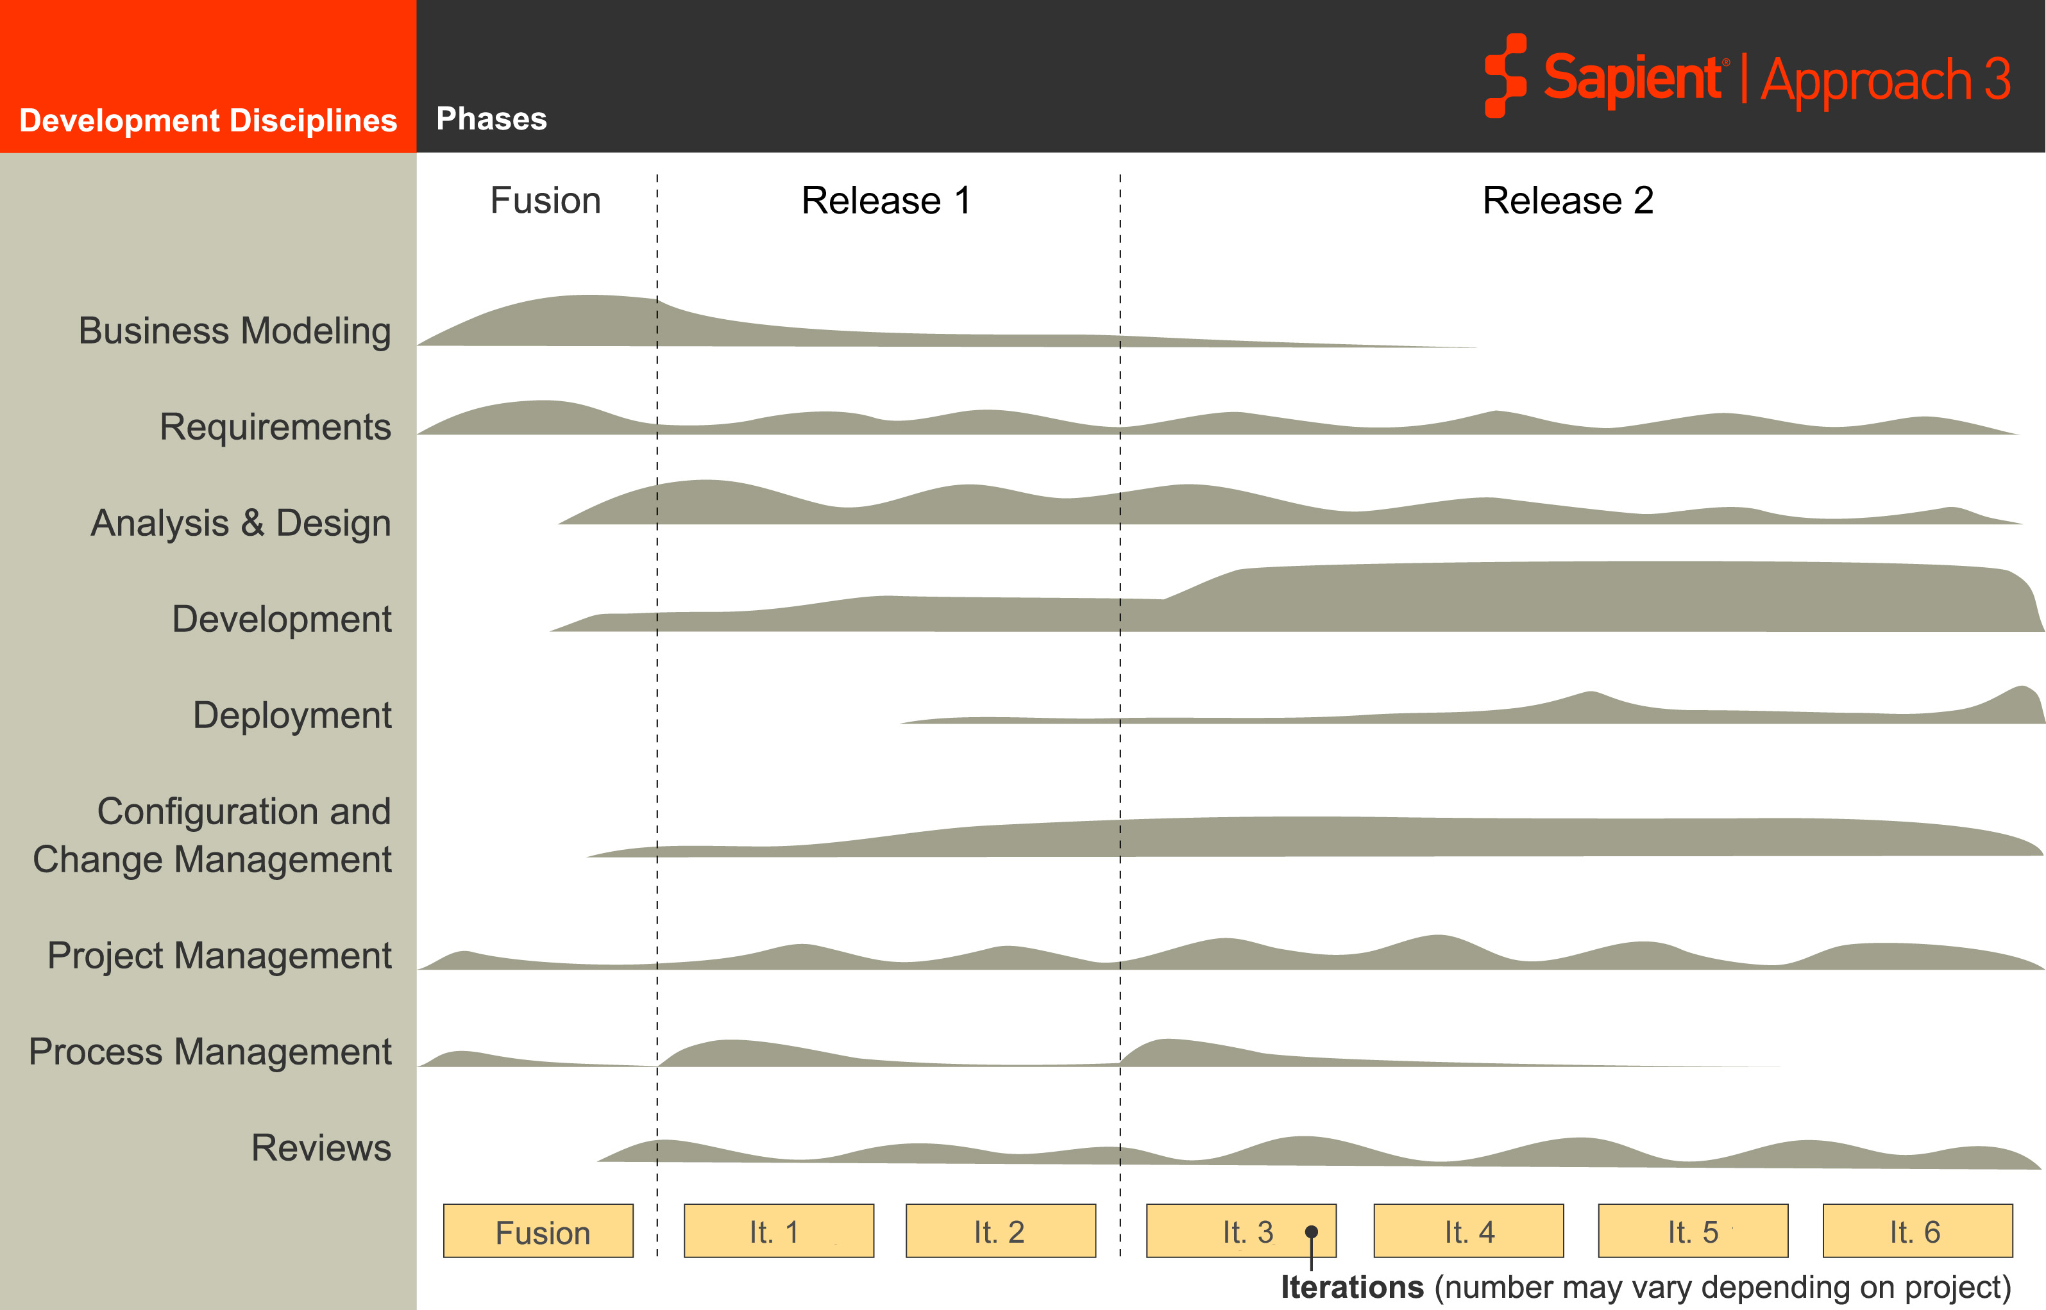
S|A 3 Project Life Cycle
Sapient|Approach 3
Fusion
EAR
Release 2
EAR
Development and testing occur throughout the project life cycle
Notes:
Speaker notes:
Note that this does not imply we start coding from day 1. What we do as part of the Development Discipline is start setting up the infrastructure as soon as we can, start looking at our testing strategy. These are all development activities.

Slide 3

Development
Core concepts
Activities
Mandatory Artefacts

Slide 4


Core Concepts
Guiding principles
  Make quality a way of life!
  Catch the defects as early as possible
Based on industry best practises
  Test driven development
  Continuous integration
  Test automation
  Full-lifecycle quality assurance
Test
Continuous
Driven
Integration
Development
Test
Full lifecycle
Automation
quality
assurance
Notes:
Speaker notes:
A critical part of the success of SA3, is using as much automation as possible, and this is reflected in automatic builds, automated unit tests, automated functional tests etc.
Set expectations that we will not be covering these in detail as this was part of the Phase 1 rollout. If people are interested, we will deliver JIT training for the team.

Slide 5
Test driven development (TDD)
Development technique whereby developers code unit tests first
Tests determine what system code you need to write
  No system code changes unless you have a failing test case
  Implement only enough code to make the tests pass
No code is checked in unless
  It has associated automated unit tests
  100% of system’s current set of unit tests execute successfully
Maintain an exhaustive suite of automated unit tests
Notes:
Some introductory points:
Coding and unit testing have been combined into Sapient's Test Driven Development (TDD) activity. This activity is largely based on the industry best practice of the same name that makes rigorous unit testing and coding a simultaneous activity
What to expect?
There may be people that push back on TDD. Avoid the temptation to get into a debate over the merits of the technique. Refer them to the process guide for more details. If they have further concerns they can reach out the SEPG.
In the end though, for TDD and all of the processes the message needs to be clear that teams must follow the standard processes. The requirement about not checking in code unless it has associated unit tests is not negotiable. It is a critical element needed to support Continuous Integration.

Slide 6
Test driven development (continued)
Incremental small steps
  Start with the simplest possible failing test
  Implement just enough system code for the test to pass (ensure all the tests in the system pass along with the newly written one)
  Repeat till you can’t find any more tests that drive writing the system code
Refactor as you progress through increments
  Generalise and remove code duplication
Scope of a unit test is typically very low level (e.g. method, class, stored procedure level)
Does not replace functional testing like integration and system testing. TDD leads to effective unit testing
Notes:
How much system code do I write?
You put a limit on the amount of the code you write. Only enough to make the test pass. This ensures you write tests for all features being implemented and further you are coding to specification e.g. if there is a decision structure in the code you would code the else block only after the test is written
Which test to start with first?
Experienced programmers may start writing the test which tests the essence of the component versus starting with the simplest possible step. Again, the idea should be to reach the green bar as early as possible, so if you feel you are going all over the place and it’s been a while since you had a green bar it is time to go back to basics and take small simple steps
What should be the size of the increment?
Many a times you could fake the increments i.e. return constants and gradually generalise by replacing the stubs with real implementation. Developers would shift between the two modes i.e. real implementation and stubs. If everything is going smooth then real implementation is larger increments are ok and over a period of time as developers get experienced with the technique they would be able to adjust to the right size. However, as the tests starts failing it is advisable to take tiny increments to prevent wandering down the rabbit hole. From TDD by example by Kent Beck ” If the tiny steps are feeling restrictive take bigger steps, if you are feeling unsure take smaller steps. TDD is a steering process, a little this way a little that way. There is no right step size”

Slide 7

Continuous integration (CI)
Philosophy
  If frequent builds are good, let’s build as often as possible
  If testing is good, let’s test as much as possible
After every code check-in
  Rebuild the entire system (clean build)
  Fully regression test the system with an automated test suite
  Publish the results of the build
  Notify the team anytime a build breaks
    Build break = compilation or unit test failures
  Resolve build breaks: If the build break cannot be rectified in a short time then rollback the offending code
When using CI it is likely that there will be multiple, complete and regression tested, builds per day
Notes:
What to expect?
You will get people that push back on this and say this it’s not feasible, won’t work on my project, it would be nice but we don’t have time for this, etc. Focus on the benefits on the next slide along with highlighting for people how much pain they go through now trying to manually bolt the system together periodically.
Points to highlight:
Build break = compile + test failures. Continuous integration is NOT just continuous compilation, it actually means regression testing the code with an automated suite of unit, integration and system tests
Talk about productivity loss on projects whenever code fails to compile. Developer either ignores by stubbing out (carries the risk of integration issues not being detected earlier) or spends lots of cycles hunting down the build break. This gets further aggravated if we are working in a GDD model when the team in a one geography does not have support from the other geography for resolving build breaks.
The effort of integration is exponentially proportional to the amount of time between integrations. If your integration is painful, you shouldn't take this as a sign that you can't integrate more frequently. Done well, more frequent integration should be painless and you end up spending much less time carrying out the integration
Microsoft does daily builds on projects with tens of millions of lines of code
Mention the pain on build days around integration issues which are very tough to catch since they are related to interaction between units versus something wrong in a specific unit.
Park the question related to tools for the next slide
Speaker should provide some build day experiences (where they spent large amounts of time integrating) from their prior projects and/or ask the participants
Ensure all the build and promotion scripts have been version controlled

Slide 8
Development
Core concepts
Activities
Mandatory Artefacts

Slide 9
Development Activities
Analysis & Design
Build & Release
Configuration Management
Test Planning
Project Management
Development
Test Driven Development
Project Management
Testing
Requirements
Reviews

Slide 10
Build and Release
Purpose:
  Synchronise the development efforts into a single version of code
Objectives:
  Synchronize the development efforts of the entire team into a single version of code that works together and is ready to be released and tested
  Advance the application baseline in a consistent, well-defined manner, making new features and fixes available to clients and to the Sapient team
  Mitigate risk by following a disciplined process to integrate code
Activities:
  Ensure continuous integration environment and automated build scripts execute properly
  Provide a snapshot of the build source code after every build (label the build)
  Deploy build to target environment
  Create and distribute release notes
Output:
  Single version of released, tested, integrated code
  Release notes

Slide 11
Test Planning
Purpose:
  Define, document and gain closure with the client on what, how and when Sapient will test the solution being built
Objectives:
  Identify what is to be tested
  Define exist criteria that will govern acceptance of the system
  Define the scope of testing activities including different types of testing that would be carried out
  Create a testing schedule
  Prescribe the testing approach
  Describe roles and responsibilities for each task
Activities:
  Test Lead creates the Test Plan
  Client and architect approve the plan
Mandatory Artefact:
  Test Plan

Slide 12
Test Driven Development
Purpose:
  Use unit tests to determine what needs to be coded
Objectives:
  Identify defects in code at the lowest level of detail
  Ensure code correctness
  Prevent integration issues during development
Activities:
  Develop and execute a failing automated Unit Test
  Write/revise the code
  Rebuild the application (as define in Build and Release)
  Check in code (only when code passes all unit tests)
Output:
  Error free, integrated, unit-tested code

Slide 13
Testing
Purpose:
  Ensure that the application meets all functional, technical and operational requirements
Objectives:
  Test the system in an environment as close to a production deployment scenario as possible
  Test non-functional aspects of the system such as performance, security, scalability and reliability, recovery, etc.
Activities:
  Design and build test scripts
  Deploy latest version of code to appropriate testing environment
  Execute automated test suites
  Document all TARs
Output:
  Automated test scripts
  Tested and integrated code

Slide 14
Mandatory artefacts: Development
Test Plan
Release notes
Automated test scripts

Slide 15

Questions?

